Slide 1

PYTHON PROGRAMMING SCS1619
Department of Computer Science and Engineering,
School of Computing
SATHYABAMA
Institute of Science and Technology
Deemed to be University
Chennai.

Slide 2
UNIT 1 INTRODUCTION

Slide 3
SYLLABUS
History of Python
Introduction to the IDLE interpreter (shell)
Expressions
Data Types
Built-in function
Conditional statements
Iterative statements
Input/output
Compound Data Types
Nested compound statements
Introduction to Object Oriented Concepts.

Slide 4
History
Python was conceived in the late 1980s by Guido van Rossum at Centrum Wiskunde & Informatica (CWI) in the Netherlands
Its implementation began in December 1989.
Comercial use from 1990 onwards

Slide 5
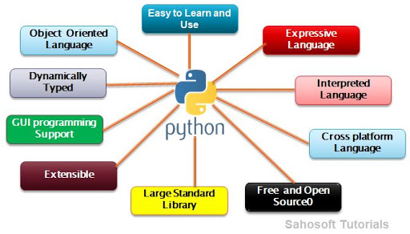
Features of Python

Slide 6
Introduction to the IDLE interpreter
Python is a freeware that can be installed on your workstation or laptop.
The current version of is Python 3.8.2. (Release date: Feb 24, 2020). Python can be downloaded from the https://www.python.org/downloads/ website
IDLE (Integrated Development and Learning Environment) is an IDE for Python
Python programs can also be executed in Python command line.

Slide 7
Points to Remember while Writing a Python Program ➢
Case sensitive
Punctuation is not required at end of the statement
In case of string use single or double quotes i.e. ‘ ’ or “ ”
Must use proper indentation
Python Program can be executed in two different modes:
Interactive Mode Programming
Script mode programming

Slide 8
Input & Output Statements
Input – to read values from the user
Syntax:
Variable=input()
Input() – function used to read values
Output- to display the result
Syntax:
print(“hello students”)
print(“welcome”)
Print(“value is”,x)

Slide 9
Expression
An expression is a combination of variables, operators, values and calls to functions.
Expressions need to be evaluated
Example:
z= a+b
p=3.14*r*r
a>b
2=ab - invalid expression

Slide 10
VARIABLES
Variable is the name given to a reserved memory locations to store values.
It is also known as Identifier in python.
Naming and Initialization of a variable
1. A variable name is made up of alphabets (Both upper and lower cases) and digits and is case sensitive
2. No reserved words
3. Initialize before calling
4. Multiple variables initialized
5. Dynamic variable initialization

Slide 11
Example
X2=25
if=30
a=45
print(A)
x=y=z=50
a,b,c=1,2,3
print(a)
print(b)
print(c)

Slide 12
Data Types
A Data type indicates which type of value a variable has in a program.
The most common data types used in python are
str (string)
int(integer)
float (floating-point).

Slide 13
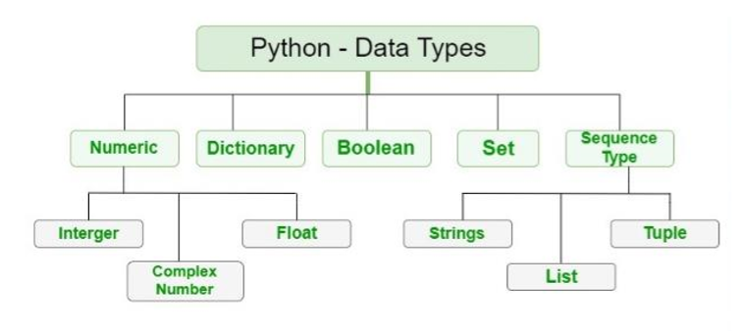

Slide 14
Numeric
Integers –
int – both +ve and –ve values can be represented
Float – float class is used to represent floating point number which is a real number with floating point representation.
float
fractional point E.g.: 3.415, 5.15
Complex Numbers
complex
For example: 5 + 7j
where 5 is the real part and 7 is the imaginary part

Slide 15
Number Type Conversion
int(x) - to convert x to a plain integer.
long(x) -to convert x to a long integer.
float(x) -to convert x to a floating-point number.
complex(x) -to convert x to a complex number with real part x and imaginary part zero.
complex(x, y) - to convert x and y to a complex number with real part x and imaginary part y. x and y are numeric expressions

Slide 16
Example
Program:
a = 10
print("Type of a: ", type(a))
b = 20.0
print("\nType of b: ", type(b))
c = 5 + 7j
print("\nType of c: ", type(c))
Output:
Type of a: <class 'int'>
Type of b: <class 'float'>
Type of c: <class 'complex'>

Slide 17
Mathematical Functions
Sr.No. | Function & Returns ( Description )
1 | abs(x) -The absolute value of x: the (positive) distance between x and zero.
2 | fabs(x) -The absolute value of x.
3 | ceil(x)-The ceiling of x: the smallest integer not less than x.
4 | floor(x) -The floor of x: the largest integer not greater than x.
5 | log(x) -The natural logarithm of x, for x > 0.
6 | min(x1, x2,...)-The smallest of its arguments: the value closest to negative infinity.
7 | modf(x) -The fractional and integer parts of x in a two-item tuple. Both parts have the same sign as x. The integer part is returned as a float.
8 | pow(x, y) -The value of x**y.
9 | round(x [,n]) -x rounded to n digits from the decimal point. Python rounds away from zero as a tie-breaker: round(0.5) is 1.0 and round(-0.5) is -1.0.

Slide 18
Boolean
The Boolean data type has two built-in values True or False.
It is denoted by the class bool.
Note – True and False with capital ‘T’ and ‘F’ are valid boolean values.
# Python program to demonstrate Boolean type print(type(True))
print(type(False))
print(type(true))
Output:
<class 'bool’>
<class 'bool’>
NameError: name 'false' is not defined

Slide 19
Sequence Type
A sequence is an ordered collection of similar or different data.
Using sequence, Multiple values can be stored in the data type in an efficient manner.
There are different types of sequence data type such as
i) Strings ii) List iii) Tuple

Slide 20
Strings
String is an array of bytes.
Each byte represents a Unicode character.
A string is a collection of one or more characters put in a single quote, double-quote or triple quote.
In python there is no character data type, a character is a string of length one.
It is represented by str class.
Individual characters of a string can be accessed by using the method of Indexing

Slide 21
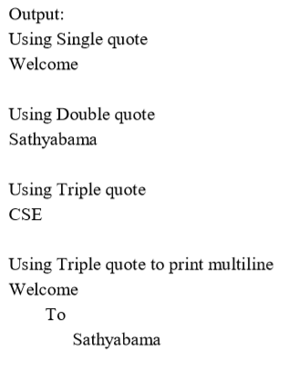
Example
Strings: Sequence of characters inside single quotes or double quotes.
E.g. myuniv = “Sathyabama !..”
PROGRAM:
# Python Program for String Manipulation
# Creating a String with single quotes, double quotes, tripple quotes
String1 = 'Welcome’
String2 = "Sathyabama"
String3 = '''CSE’‘’ # Triple Quotes allows multiple lines
String4 = '''Welcome
To
Sathyabama‘’’
print("\nUsing Single quote")
print(String1)
print("\nUsing Double quote")
print(String2)
print("\nUsing Triple quote")
print(String3)
print("\nUsing Triple quote to print multiline")
print(String4)

Slide 22
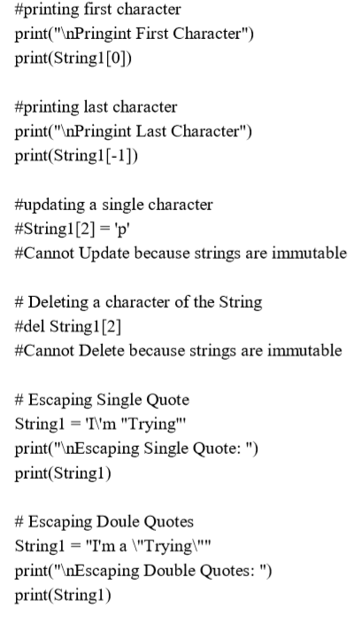
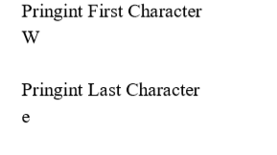
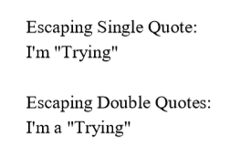

Slide 23
List
The List is an ordered sequence of data items.
It is one of the flexible and very frequently used data type in Python.
All the items in a list are not necessary to be of the same data type.
Declaring a list is straight forward methods.
Items in the list are just separated by commas and enclosed within brackets [ ]
Example: li=[10,2,3,45]
list1 =[3.141, 100, ‘CSE’, ‘ECE’, ‘IT’, ‘EEE’]

Slide 24
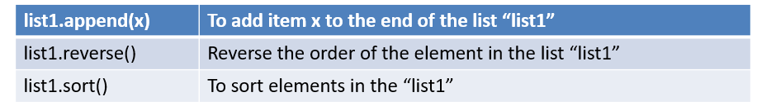
List Methods
A single list may contain Data Types like Integers, Strings, as well as Objects.
Lists are mutable.
Lists are ordered and have definite count.
The list index starts with 0.
Duplication of elements is possible in list. The lists are implemented by list class.

Slide 25
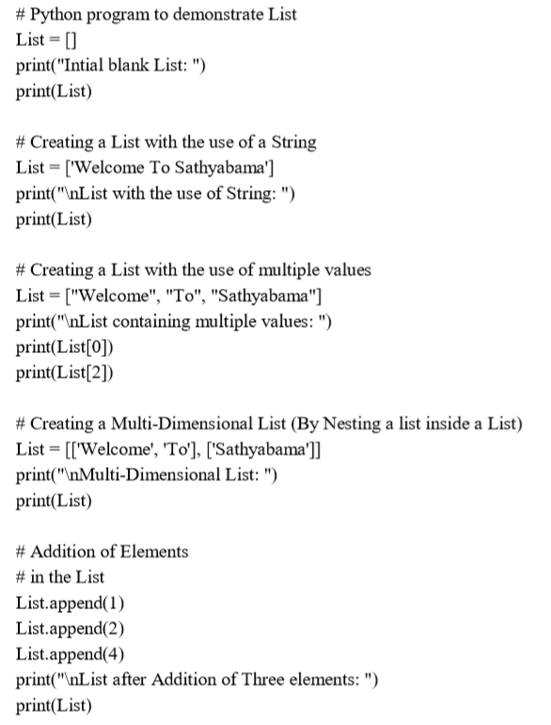
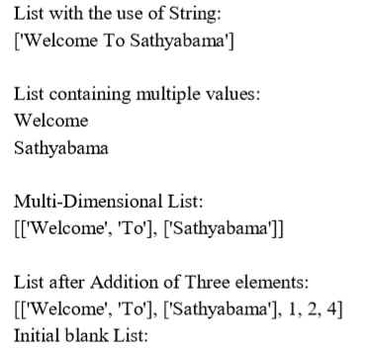

Slide 26
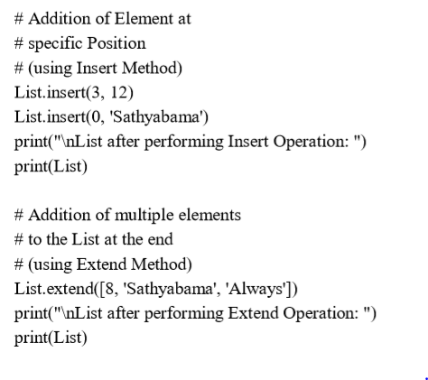
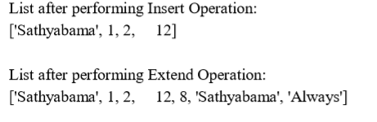

Slide 27
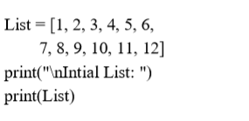
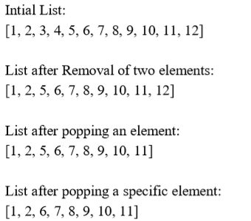
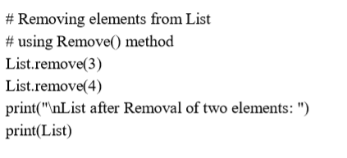
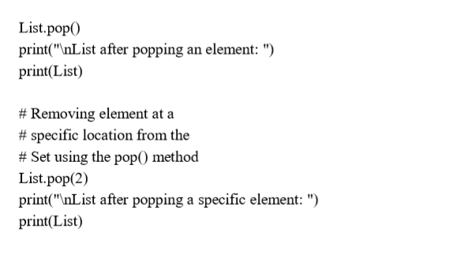

Slide 28

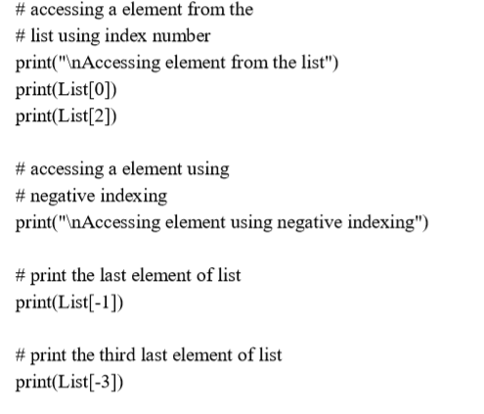
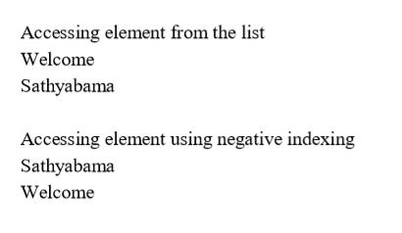

Slide 29
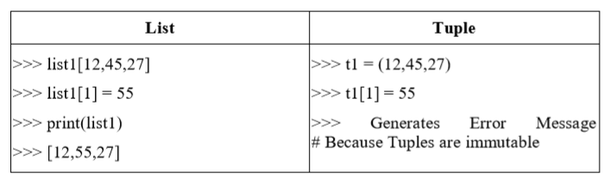
Tuple
Tuple is also an ordered sequence of items of different data types like list.
But, in a list data can be modified even after creation of the list whereas Tuples are immutable and cannot be modified after creation.
Example: t = (50,'python', 2+3j)

Slide 30
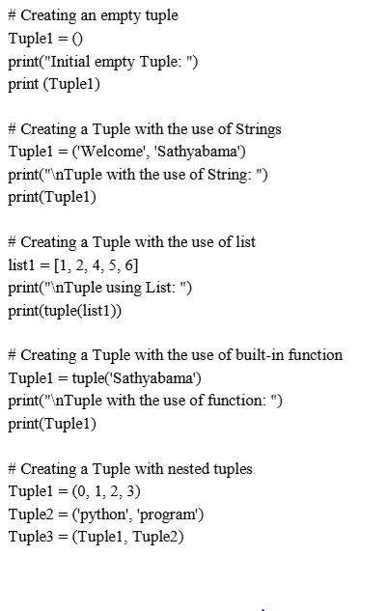
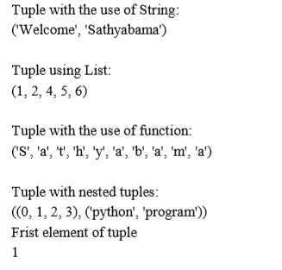


Slide 31
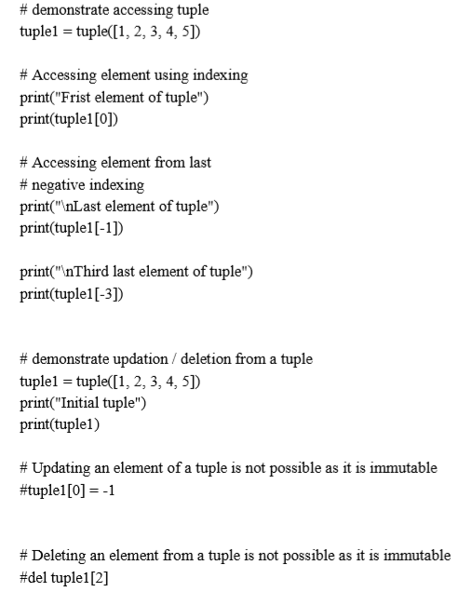
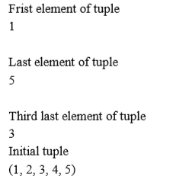

Slide 32
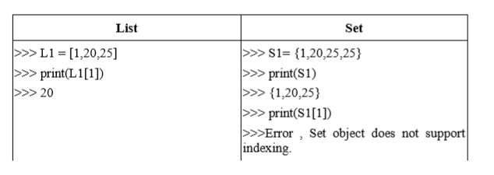
Set
The Set is an unordered collection of unique data items.
Items in a set are not ordered, separated by comma and enclosed inside { } braces.
Sets are helpful in performing operations like union and intersection.
The major advantage of using a set, as opposed to a list, is that it has a highly optimized method for checking whether a specific element is contained in the set.

Slide 33
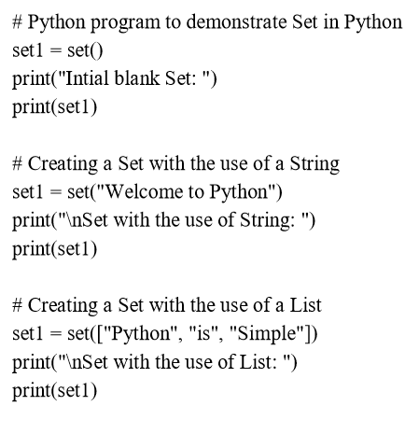
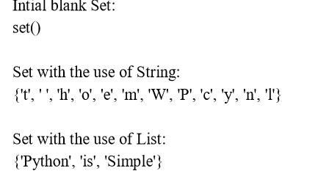
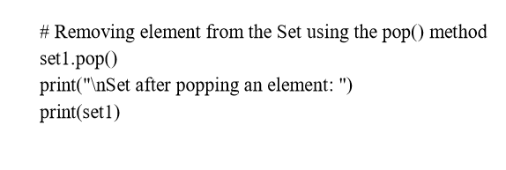
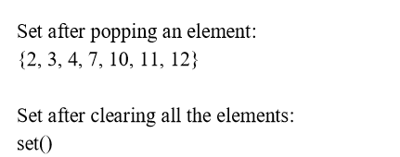
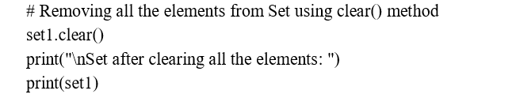

Slide 34
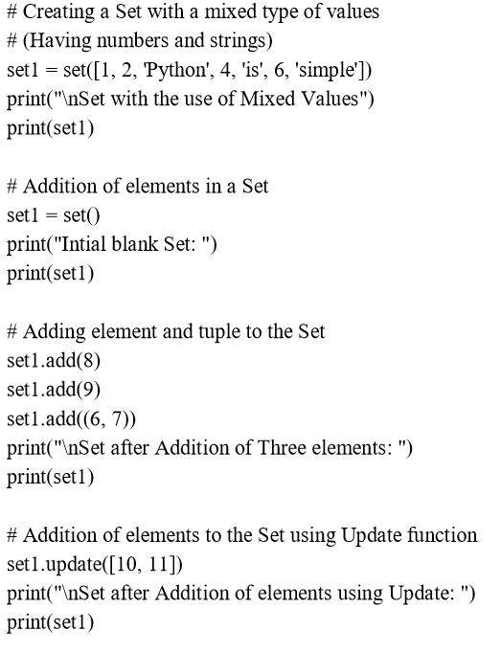
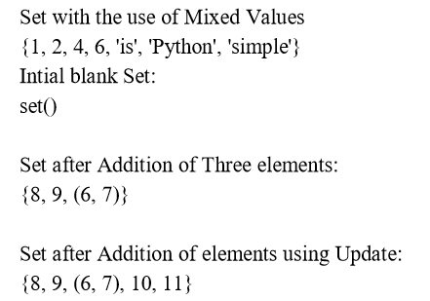

Slide 35
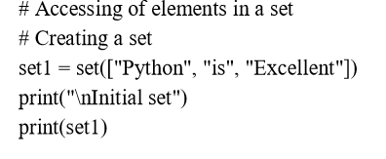
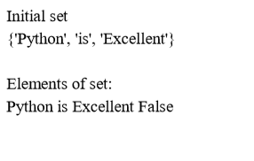
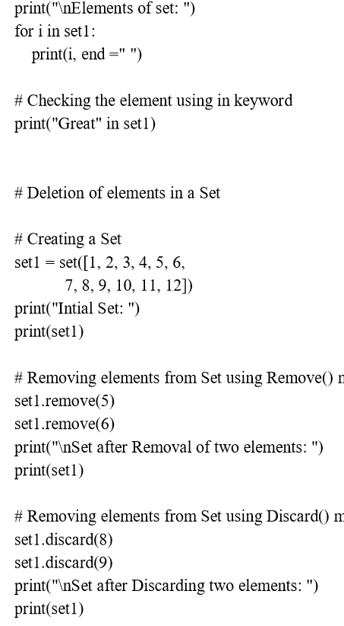
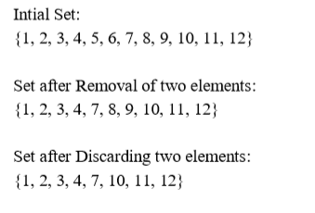

Slide 36
Dictionary
Dictionary is an unordered collection of data values.
It is used to store data values like a map.
Dictionary holds key:value pair.
Key-value is provided in the dictionary to make it more optimized.
Each key-value pair is separated by a colon :, whereas each key is separated by a ‘comma’.
Example: dict={1:”Jan”, 2:”Feb”, 3:”March”}

Slide 37
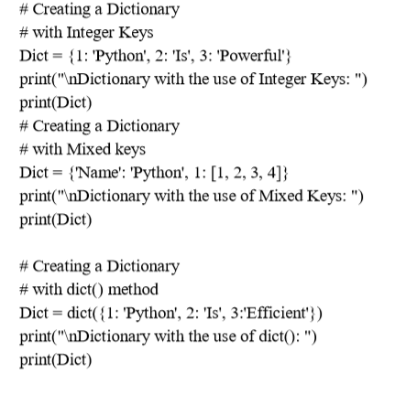
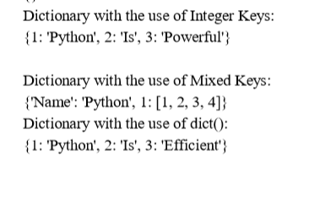

Slide 38
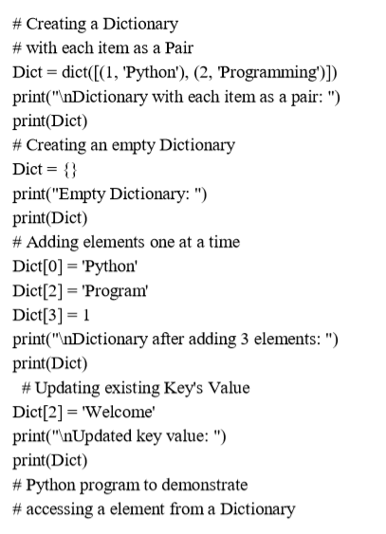
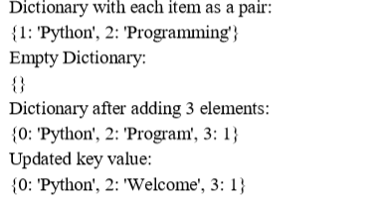

Slide 39
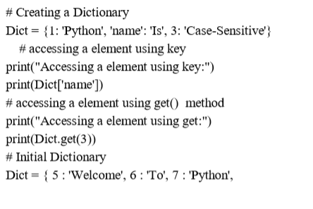
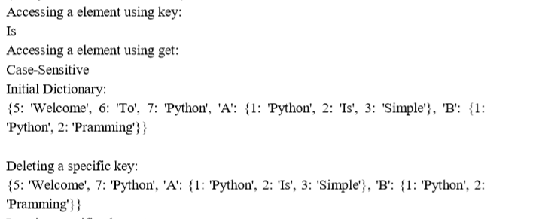
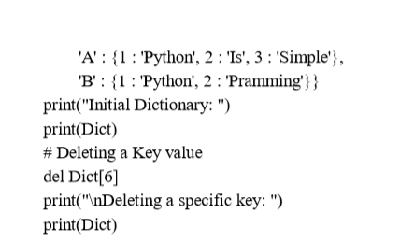

Slide 40
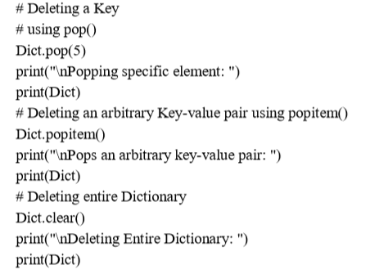
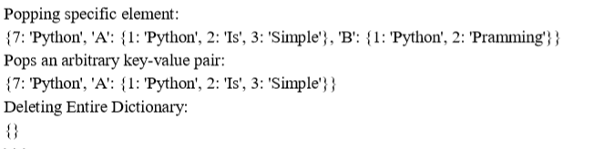

Slide 41
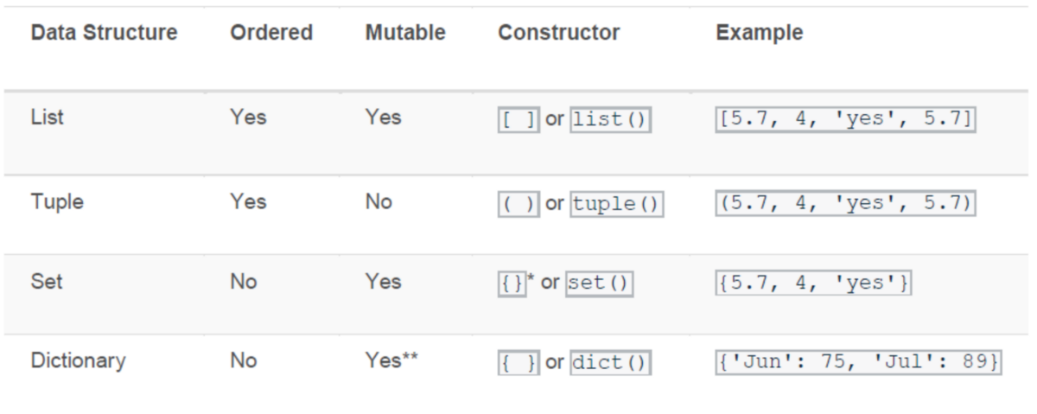
Difference Between List Tuple Set And Dictionary

Slide 42
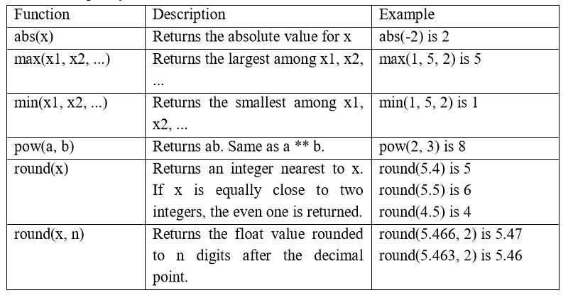
Python Built-in Functions
A function is a group of statements that performs a specific task. Python provides a library of functions like any other programming language.
Mathematical Functions, String Functions

Slide 43
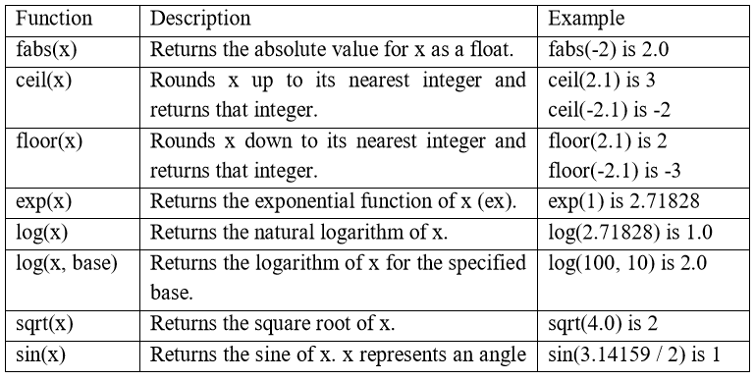
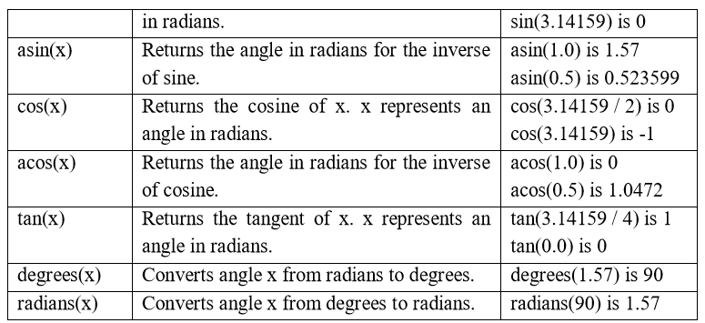
Mathematical Functions

Slide 44
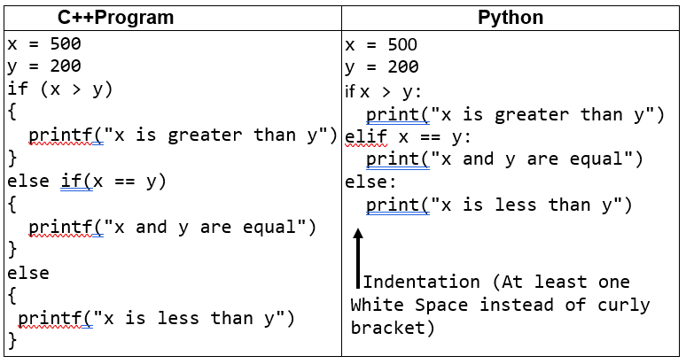
Conditional Statements
Logical Conditions Supported by Python
Equal to (==) Eg: a == b
Not Equal (!=) Eg : a != b
Greater than (>) Eg: a > b
Greater than or equal to (>=) Eg: a >= b
Less than (<) Eg: a < b
Less than or equal to (<=) Eg: a <= b

Slide 45
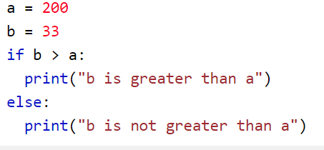
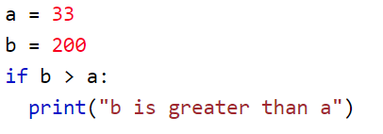

Types of Conditional Statements
Simple if statement
if – else statement
elif- statement
Nested if else statement

Slide 46






Slide 47
Iterative Statements
Sometimes certain section of the code (block) may need to be repeated again and again as long as certain condition remains true.
while loop statement
For loop statement

Slide 48


While Loop
A while loop statement in Python programming language repeatedly executes a target statement as long as a given condition is true.

Slide 49






Using break, continue, else Statements

Slide 50




For loop
With the for loop we can execute a set of statements, once for each item in a list, tuple, set etc.

Slide 51







Slide 52






The range() Function
range() only works with the integers.
All arguments must be integers.
You can not use float number or any other type in a start, stop and step argument of a range()

Slide 53






_ -ve range()
-ve to +ve range
+ ve to –ve range

Slide 54


Example

Slide 55
Compound Data Type
List
Tuple
Set
Dictionary

Slide 56
Compound Statements
It is a statement comprise of group of statements
The compound statements are usually executes, when a condition satisfies or a code block is called directly or through a function call.
Example:
If statement
While Statement
For Statement
Try-Catch in Exception Handling
Class Definition
Function Definition

Slide 57

Nested Compound Statement
Program to find the shipping cost of in Australia, if the total cost is 25$.

Slide 58





Slide 59


Display Floyd’s triangle using Python nested for loop

Slide 60

Functions
A function is a block of organized, reusable code that is used to perform a single, related action.
Functions provide better modularity for your application and a high degree of code reusing.

Slide 61


Example

Slide 62


Pass by Value

Slide 63
Object Oriented Programming
Python is a multi-paradigm programming language. It supports different programming approaches.
One of the popular approaches to solve a programming problem is by creating objects. This is known as Object-Oriented Programming (OOP).
An object has two characteristics:
attributes
behavior
Let's take an example:
A parrot is can be an object, as it has the following properties:
name, age, color as attributes
singing, dancing as behavior

Slide 64
OOPS Concepts
Class and Object
Encapsulation
Abstraction
Inheritance
Polymorphism

Slide 65
Class
A class is a blueprint for the object.
We can think of class as a sketch of a parrot with labels.
It contains all the details about the name, colors, size etc. Based on these descriptions, we can study about the parrot.
Here, a parrot is an object.
The example for class of parrot can be :
Class Parrot:
Data member
Method

Slide 66
Object
An object (instance) is an instantiation of a class. When class is defined, only the description for the object is defined.
Therefore, no memory or storage is allocated.
The example for object of parrot class can be:
Obj=Parrot()
Here: obj-> object
Parrot()-> class

Slide 67


Creating Class and Object in Python

Slide 68


A program to understand class variables s

Slide 69

Constructors
Constructors are generally used for instantiating an object.
The task of constructors is to initialize(assign values) to the data members of the class when an object of class is created.
In Python the __init__() method is called the constructor and is always called when an object is created.

Slide 70
Types of constructors
Default constructor :
The default constructor is simple constructor which doesn’t accept any arguments.
It’s definition has only one argument which is a reference to the instance being constructed.
parameterized constructor :
constructor with parameters is known as parameterized constructor.
The parameterized constructor take its first argument as a reference to the instance being constructed known as self and the rest of the arguments are provided by the programmer.

Slide 71

Default Constructor

Slide 72


Parameterized Constructor

Slide 73
Encapsulation & Abstraction
Encapsulation:
It is a mechanism where the data and the code that act on the data will be bind together.
Example:
Class
Visibility Mode: By default Public
Abstraction:
Explore only the data that is of interest to the user.
Example: Car
Adv: Every user will get his own view of the data according to his requirements and will not confused with unnecessary data.
Keywords: public, private, protected

Slide 74






Access Modifiers in Python

Slide 75
Inheritance
Inheritance allows us to define a class that inherits all the methods and properties from another class.
Parent class is the class being inherited from, also called base class.
Child class is the class that inherits from another class, also called derived class.
Syntax for derived class:
Class A:
Base Class definition
Class B(A):
Derived Definition

Slide 76

Types of Inheritance

Slide 77

Single Inheritance

Slide 78


Multiple Inheritance

Slide 79


Multilevel Inheritance

Slide 80


Hierarchical Inheritance

Slide 81
Polymorphism
Polymorphism is a very important concept in programming.
It refers to the use of a single type entity (method, operator or object) to represent different types in different scenarios.
Types:
Function Overloading
Operator Overloading

Slide 82

Function Overloading
Process of using same function name to perform multiple operation
Example:

Slide 83

Operator Overloading
Defining methods for operator is known as operator overloading.

Slide 84

Operator Overloading

